Slide 1

BCS2313: Artificial Intelligence Techniques
Module 2.4:
ADVANCED SEARCH (GENETIC ALGORITHM)

Slide 2
What You’ll Learn
Genetic Algorithms (GA)
Natural Evaluation vs. Artificial Evaluation
GA Steps
Population
Selection
Reproduction
GA Example

Slide 3
How Natural Evaluation Works
Natural evaluation is based on processes of reproduction, mutation, competition and selection. The power to reproduce appears to be an essential property of life. The power to mutate is also guaranteed in any living organism that reproduces itself in a continuously changing environment. Processes of competition and selection normally take place in the natural world, where expanding populations of different species are limited by a finite space.

Slide 4
How Natural Evaluation Works
Evolution can be seen as a process leading to the maintenance of a population’s ability to survive and reproduce in a specific environment. This ability is called evolutionary fitness.
Evolutionary fitness can also be viewed as a measure of the organism’s ability to anticipate changes in its environment.
The fitness, or the quantitative measure of the ability to predict environmental changes and respond adequately, can be considered as the quality that is optimized in natural life.

Slide 5
How Natural Evaluation Works
Let us consider a population of rabbits. Some rabbits are faster than others, and we may say that these rabbits possess superior fitness, because they have a greater chance of avoiding foxes, surviving and then breeding.
If two parents have superior fitness, there is a good chance that a combination of their genes will produce an offspring with even higher fitness. Over time the entire population of rabbits becomes faster to meet their environmental challenges in the face of foxes.

Slide 6
Simulation of Natural Evaluation
All methods of evolutionary computation simulate natural evolution by creating a population of individuals, evaluating their fitness, generating a new population through genetic operations, and repeating this process a number of times.
We will start with Genetic Algorithms (GAs) as most of the other evolutionary algorithms can be viewed as variations of genetic algorithms.

Slide 7
Genetic Algorithms
In the early 1970s, John Holland introduced the concept of genetic algorithms.
His aim was to make computers do what nature does. Holland was concerned with algorithms that manipulate strings of binary digits.
Each artificial “chromosomes” consists of a number of “genes”, and each gene can be represented by 0, 1, A, a, B, Z, 9, 3 etc.

Slide 8
Genetic Algorithms
Nature has an ability to adapt and learn without being told what to do. In other words, nature finds good chromosomes blindly. GAs do the same. Two mechanisms link a GA to the problem it is solving: encoding and evaluation.
The GA uses a measure of fitness of individual chromosomes to carry out reproduction. As reproduction takes place, the crossover operator exchanges parts of two single chromosomes, and the mutation operator changes the gene value in some randomly chosen location of the chromosome.

Slide 9
Genetic Algorithm Steps
Step 1:
Represent the problem variable domain as a chromosome of a fixed length, choose the size of a chromosome population N, the crossover probability p_{c} and the mutation probability p_{m} .
Step 2:
Define a fitness function to measure the performance, or fitness, of an individual chromosome in the problem domain. The fitness function establishes the basis for selecting chromosomes that will be mated during reproduction.

Slide 10
Genetic Algorithm Steps
Step 3:
Randomly generate an initial population of chromosomes of size N:
x₁; x₂; . . . ; x_{N}
Step 4:
Calculate the fitness of each individual chromosome:
f(x₁) , f(x₂) , . . . , f(x_{N})

Slide 11
Genetic Algorithm Steps
Step 5:
Select a pair of chromosomes for mating from the current population. Parent chromosomes are selected with a probability related to their fitness. Highly fit chromosomes have a higher probability of being selected for mating than less fit chromosomes.
Step 6:
Create a pair of offspring chromosomes by applying the genetic operators – crossover and mutation.

Slide 12
Genetic Algorithm Steps
Step 7:
Place the created offspring chromosomes in the new population.
Step 8:
Repeat Step 5 until the size of the new chromosome population becomes equal to the size of the initial population, N.

Slide 13
Genetic Algorithm Steps
Step 9:
Replace the initial (parent) chromosome population with the new (offspring) population.
Step 10:
Go to Step 4, and repeat the process until the termination criterion is satisfied.

Slide 14
Two Big Questions of the Universe
parents
selection
modification
modified
offspring
initiate &
population
evaluation
evaluate
evaluated offspring
deleted
members
discard

Slide 15
The GA Cycle of Reproduction
children
Selection
modification
modified
children
parents
population
evaluation
evaluated children
deleted
members
discard

Slide 16
Initial Population

Slide 17
Population
Chromosomes could be:
Bit strings (0101 ... 1100)
Real numbers (43.2 -33.1 ... 0.0 89.2)
Permutations of element (E11 E3 E7 ... E1 E15)
Lists of rules (R1 R2 R3 ... R22 R23)
Program elements (genetic programming)
... any data structure ...
population

Slide 18
Parents Selection

Slide 19
Reproduction
children
selection
parents
population
Parents are selected at random with selection chances biased in relation to chromosome evaluations.

Slide 20
Evaluation
The evaluator decodes a chromosome and assigns it a fitness measure
modified
children
evaluated
children
evaluation

Slide 21
Fitness Function

Slide 22
Fitness Function
The fitness function basically determines which possible solutions get passed on to multiply and mutate into the next generation of solutions.
Usually done by analyzing the "genes," which hold some data about a particular solution to the problem you are trying to solve.
The fitness function will look at the genes and make some qualitative assessment, returning a fitness value for that solution.

Slide 23
Fitness Function
The rest of the genetic algorithm will discard any solutions with a "poor" fitness value and accept any with a "good" fitness value.
In short: the goal of a fitness function is to provide a meaningful, measurable, and comparable value given a set of genes.

Slide 24
Parent/Survivor Selection
Strategies
Always keep the best one
Delete the worse
Selection of the parents of the next generation of candidate solutions.
Selection methods : Roulette wheel & Tournament.

Slide 25
Parent/Survivor Selection
Too strong fitness selection bias can lead to sub-optimal solution
Too little fitness bias selection results in unfocused and meandering search

Slide 26
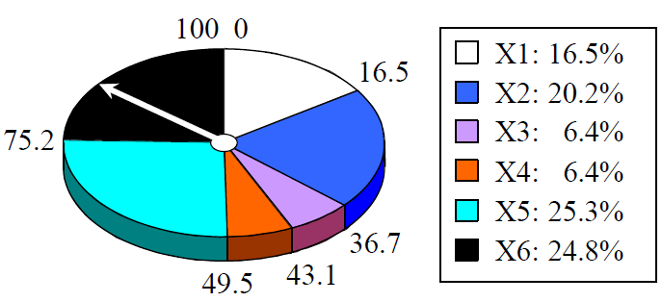
Roulette wheel
Add up the fitness's of all chromosomes
Generate a random number R in that range
Select the first chromosome in the population that - when all previous fitness’s are added - gives you at least the value R

Slide 27
Tournament
Binary tournament
Two individuals are randomly chosen; the fitter of the two is selected as a parent
Probabilistic binary tournament
In this variant, two individuals are chosen at random and the better of the two individuals is selected with fixed probability p, 0.5<p<1
Larger tournaments
n individuals are randomly chosen; the fittest one is selected as a parent
By changing n and/or p, the GA can be adjusted dynamically

Slide 28
Reproduction operators
-Crossover
-Mutation

Slide 29
Chromosome Modification
Modifications are stochastically triggered
Operator types are:
Mutation
Crossover (recombination)
children
modification
modified children

Slide 30
Reproduction
Crossover
Two parents produce two offspring
There is a chance that the chromosomes of the two parents are copied unmodified as offspring
There is a chance that the chromosomes of the two parents are randomly recombined (crossover) to form offspring
Generally the chance of crossover is between 0.6 and 1.0
Mutation
There is a chance that a gene of a child is changed randomly
Generally the chance of mutation is low (e.g. 0.001)

Slide 31
Crossover Operator
Generating offspring from two selected parents
Single point crossover
Two point crossover (Multi point crossover)

Slide 32
Crossover Operator
Crossover is a genetic operator used to vary the programming of a chromosome from one generation to the next.
It is analogous to reproduction and biological crossover, upon which genetic algorithms are based.
Crossover is a process of taking more than one parent solutions and producing a child solution from them.
Crossover techniques: One-point crossover, Two-point crossover and Uniform Crossover

Slide 33
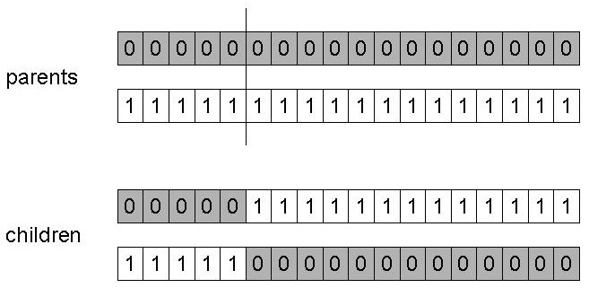
One-Point Crossover
Randomly one position in the chromosomes is chosen
Child 1 is head of chromosome of parent 1 with tail of chromosome of parent 2
Child 2 is head of 2 with tail of 1

Slide 34
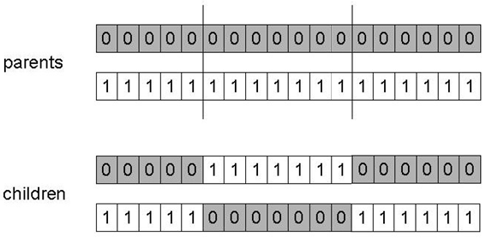
Two-Point Crossover
Randomly two positions in the chromosomes are chosen
Avoids that genes at the head and genes at the tail of a chromosome are always split when recombined

Slide 35
Mutation Operator
Mutation is a genetic operator used to maintain genetic diversity from one generation of a population of algorithm chromosomes to the next.
It is analogous to biological mutation.
Mutation alters one or more gene values in a chromosome from its initial state.

Slide 36
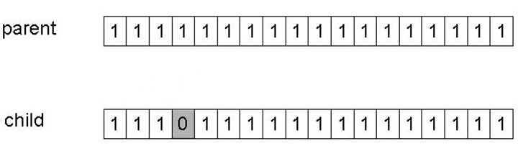
Mutation
Alter each gene independently with a probability pm
pm is called the mutation rate

Slide 37
GA Example

Slide 38
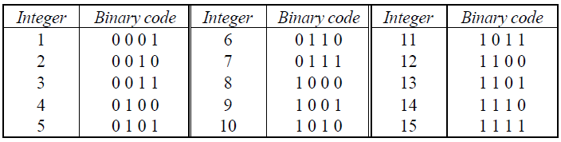
Case Study
Let us find the maximum value of function (15x – x² ) where parameter x varies between 1 to 15. For simplicity, we may assume that x only takes integer value. Thus, table below shows the possible chromosomes that build with only four genes.

Slide 39
Suppose that size of the chromosomes population N is 6, the crossover probability p_{c} equals 0.7, and the mutation probability p_{m} equals 0.001. The fitness function is define by
f(x) = 15x – x²

Slide 40
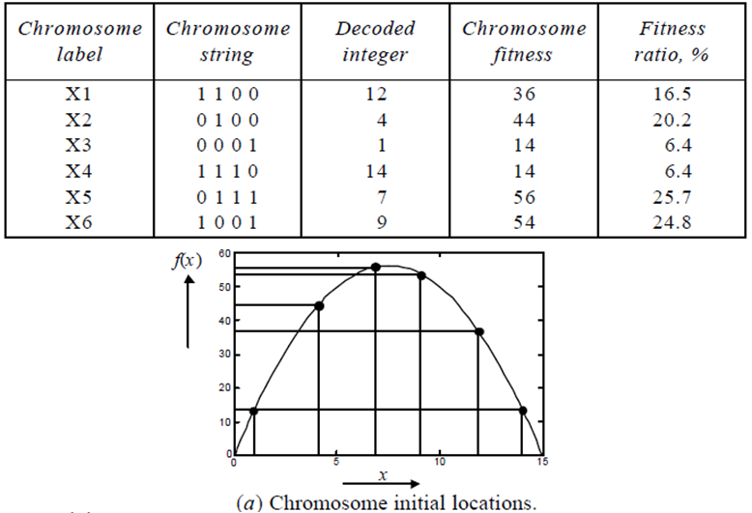
The Fitness Function & Chromosome Location

Slide 41
Selection: Roulette Wheel
Chromosome selection technique: Roulette wheel

Slide 42
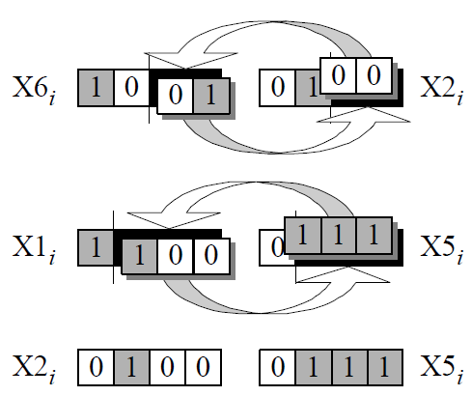
Crossover

Slide 43
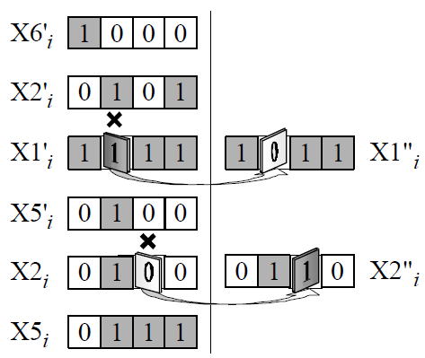
Mutation

Slide 44
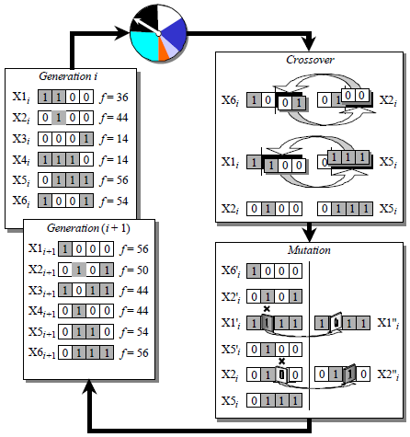
The Genetic Algorithm Cycle

Slide 45
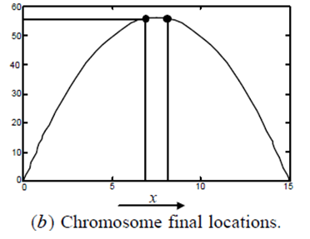
Optimum Solution
7 and 8 are the optimum number for f(x) = 15x – x²

Slide 46
GA Example
Crossover probability, P_{C} = 1.0
Mutation probability, P_{M} = 0.0
Maximise f(x) = x³ - 60 * x² + 900 * x +100
0 <= x >= 31
x can be represented using five binary digits

Slide 47
GA Example
Generate random individuals

Slide 48
GA Example
Choose Parents, using roulette wheel selection
Crossover point is chosen randomly

Slide 49
GA Example - Crossover
P₃
1
0
1
1
1
P₄
0
0
1
0
0
P₂
0
1
1
1
1
P₂
0
1
1
1
1
C₁
1
1
1
1
1
C₃
0
0
1
1
1
C₂
0
0
1
1
1
C₄
0
1
1
0
0

Slide 50
GA Example - After First Round of Breeding
The average evaluation has risen
P₂, was the strongest individual in the initial population. It was chosen both times but we have lost it from the current population
We have a value of x=7 in the population which is the closest value to 10 we have found

Slide 52

52

